Slide 1
How to make a Website Using
Scratch 3.0

Slide 2
Agenda
Create a Scratch Account
Learn how to add sprites and buttons
Learn how to change backgrounds and add webpages
Build a “My Favorite Animals” website
If time, add movement to our project
Discuss ways to use this project in content-areas

Slide 3
Open Scratch 3.0
Go To: https://scratch.mit.edu/
Join Scratch or Click “For Educators” to create a teacher account - there’s a delay to creating a teacher account, while Scratch verifies your information. Doesn’t take too long.

Slide 4
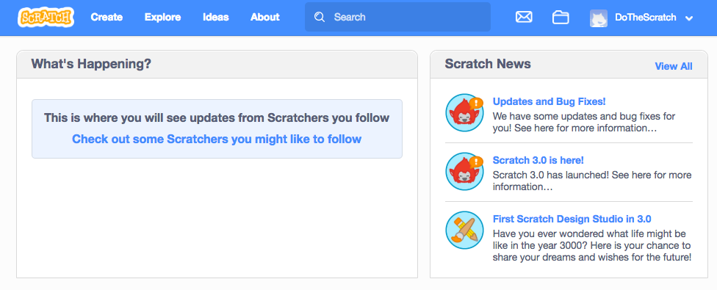
Open Scratch 3.0
Once you’re in, click “Create” to open a new project.

Slide 5
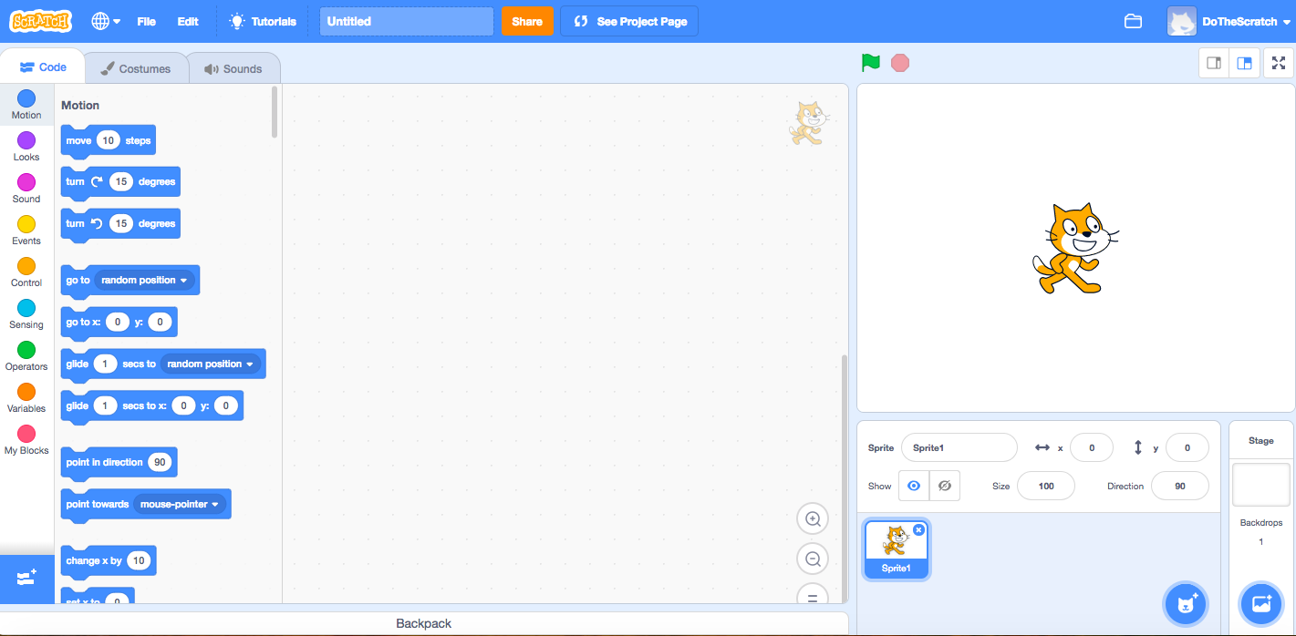
Project Screen and Workspace

Slide 6
3 Things to Notice - Code
The space where you write computer code. Drag and drop.

Slide 7
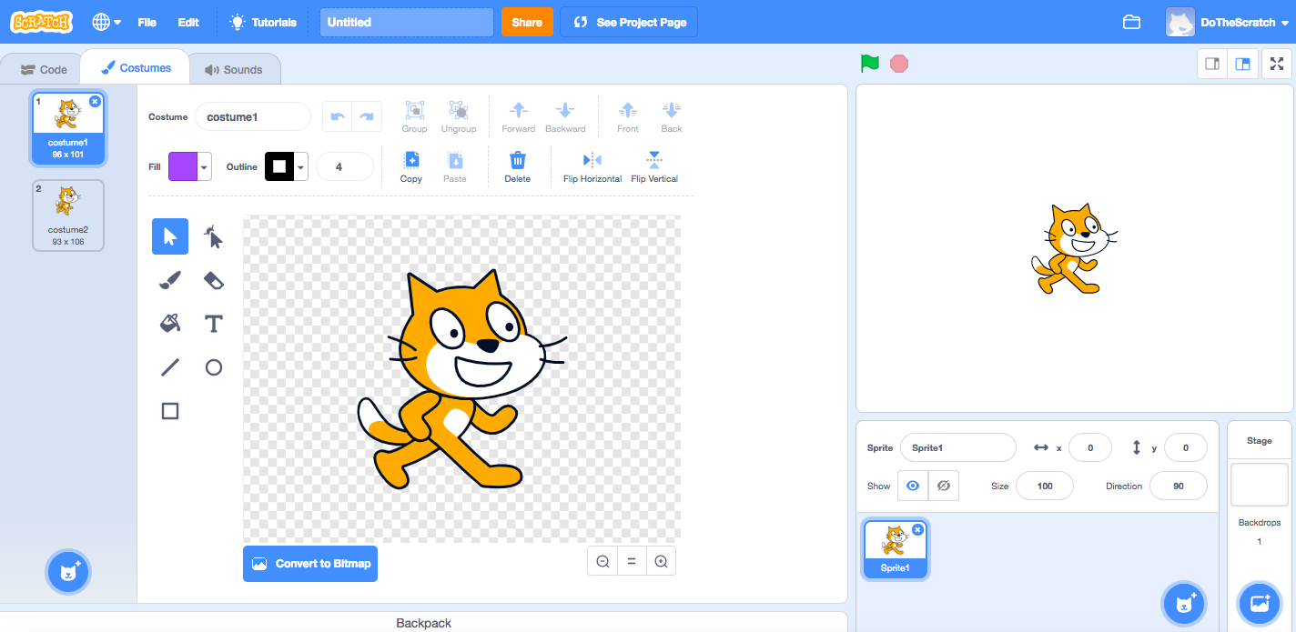
3 Things to Notice - Costumes
Where you can change how a sprite looks.

Slide 8
3 Things to Notice - Costumes

Slide 9
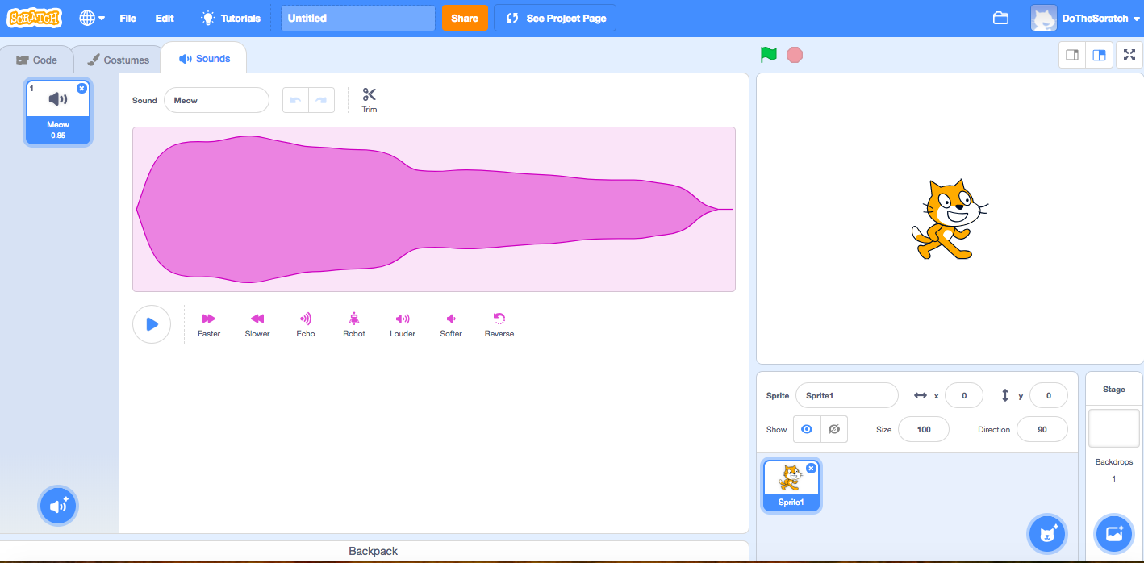
3 Things to Notice
The Meow sound is already added. But, you can record any sound and save it.

Slide 10
Create Your Homepage
Delete the Cat
Add a Button (Sprite)
Change the Background Color

Slide 11
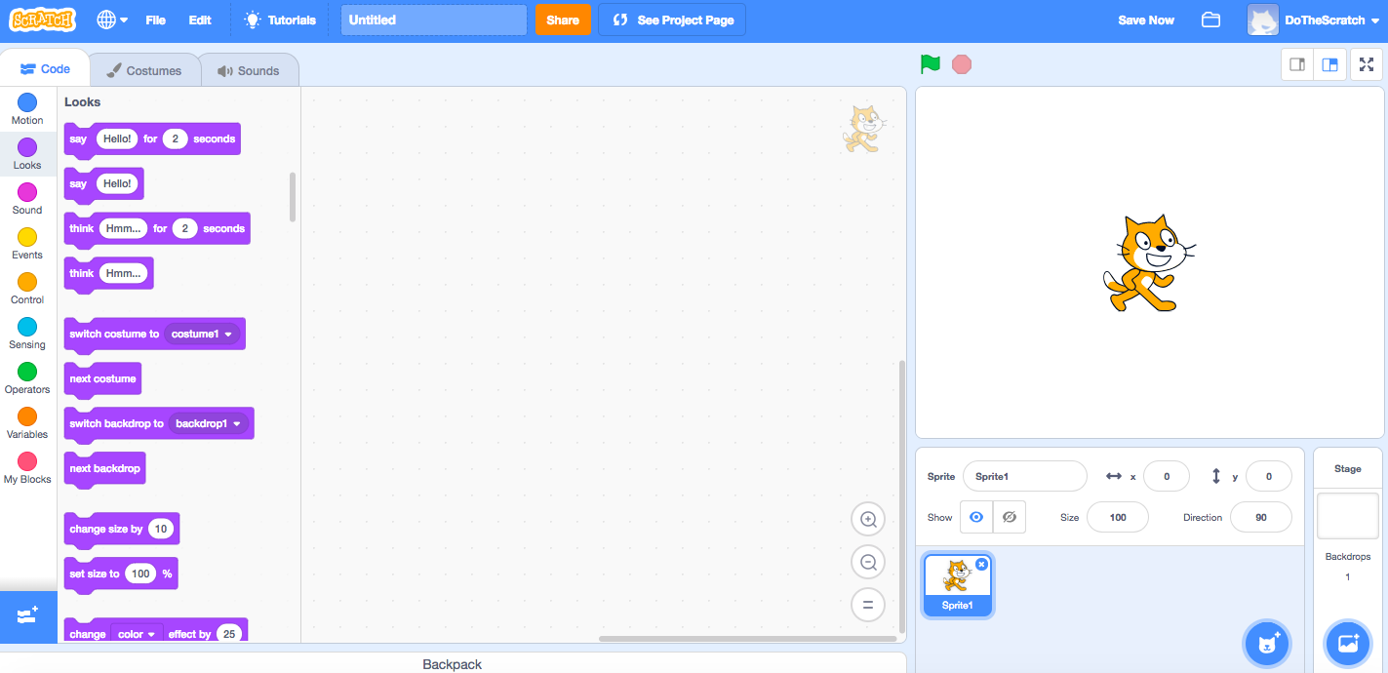
Create Your Homepage - Delete the Cat
Delete the Cat

Slide 12
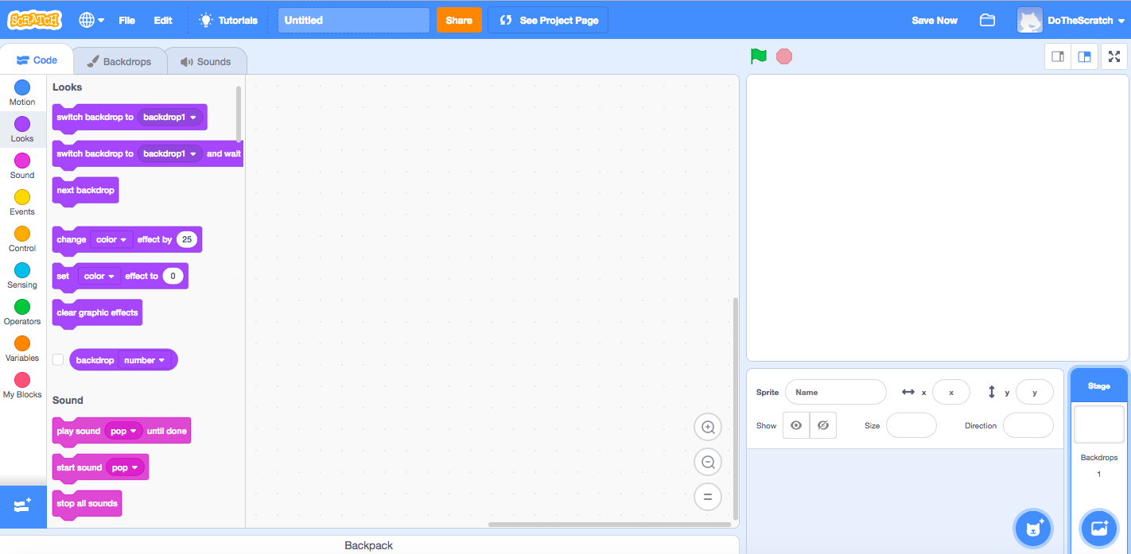
Create Your Homepage - Add a New Sprite

Slide 13
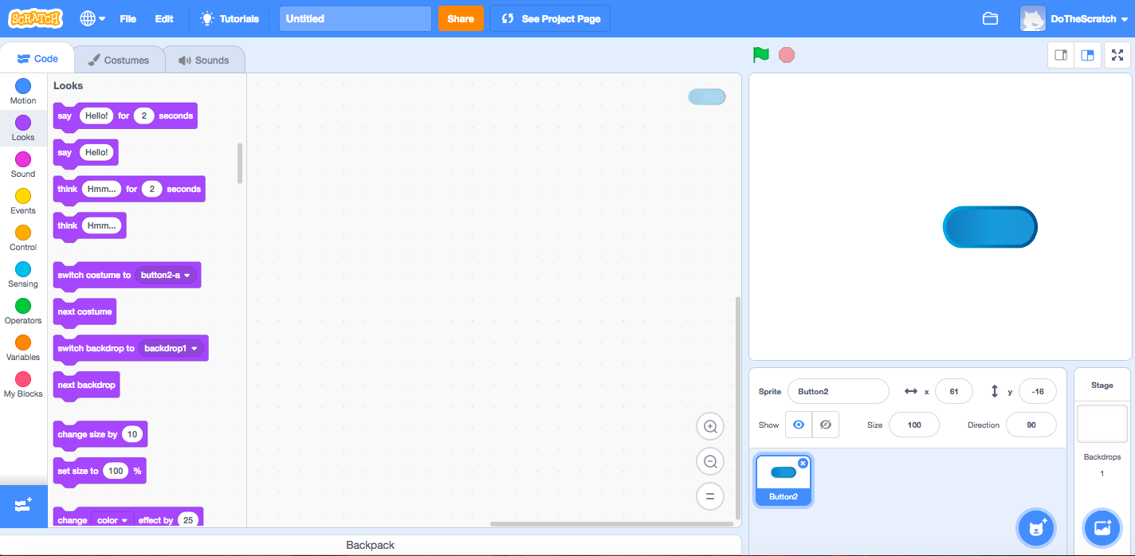
Create Your Homepage - Add a Button (New Sprite)

Slide 14
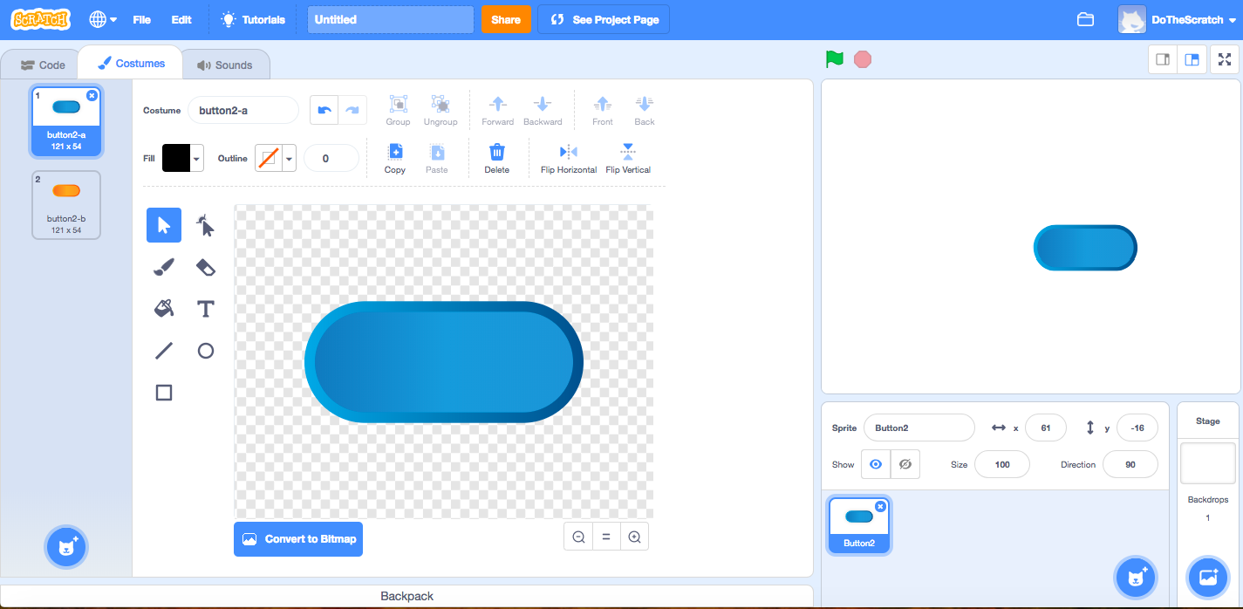
Create Your Homepage
Click Costumes
Click “T” for text

Slide 15
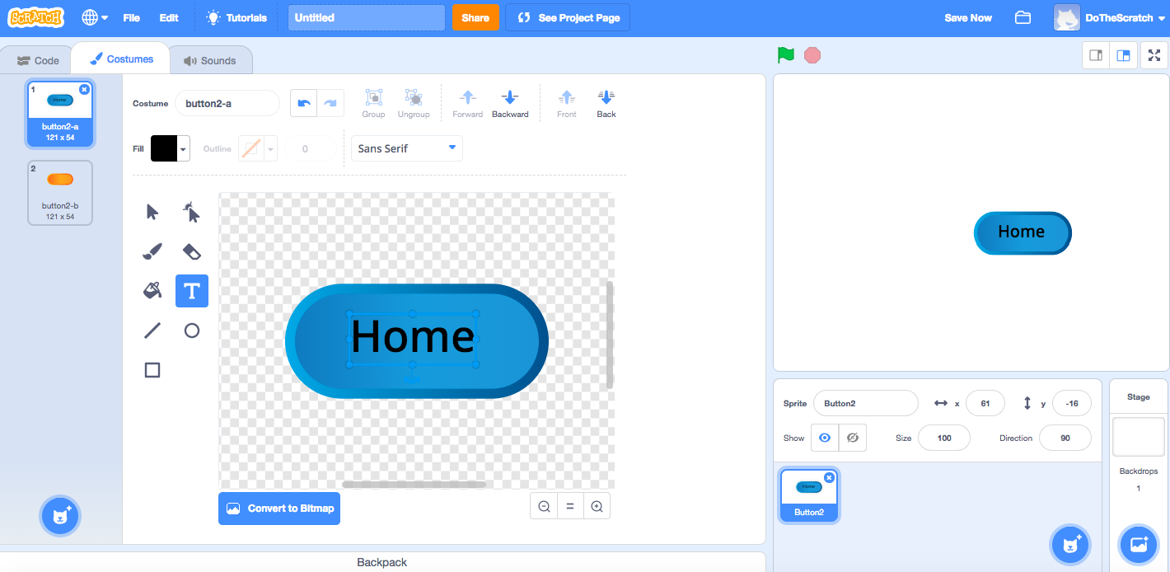
Create Your Homepage
Getting the color and position can be tricky.
Click off the button, and use arrows to move letters.

Slide 16
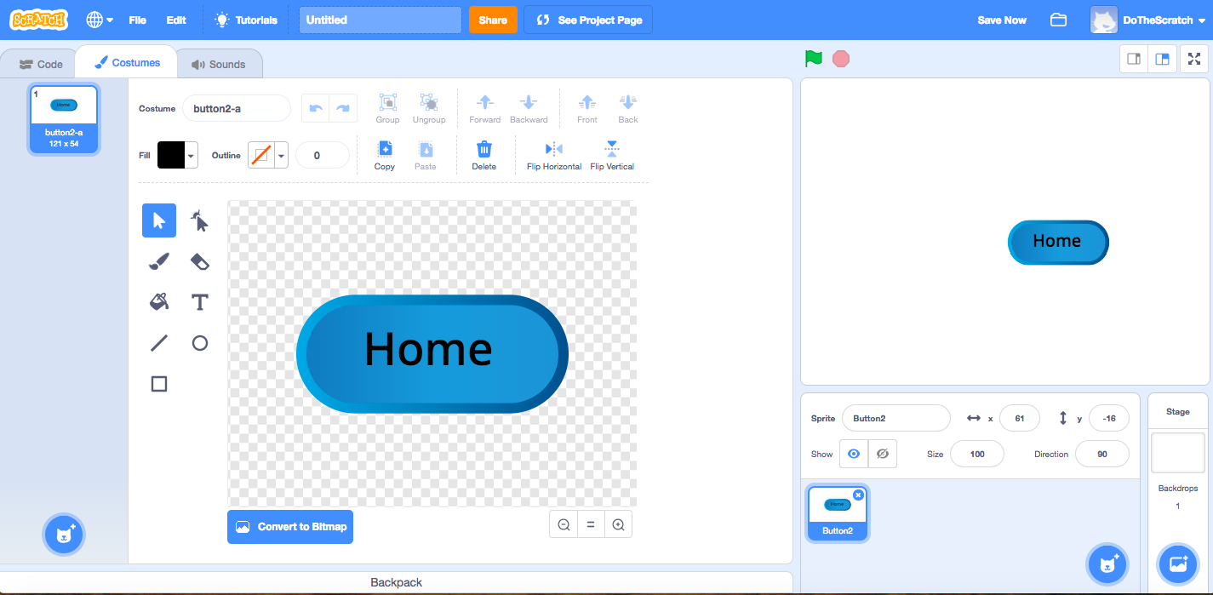
Create Your Homepage - Change Background Color
Click “Backdrop”

Slide 17
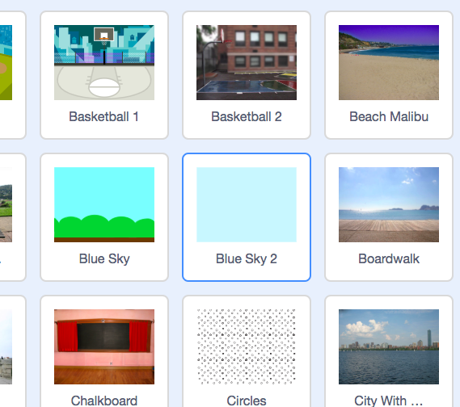
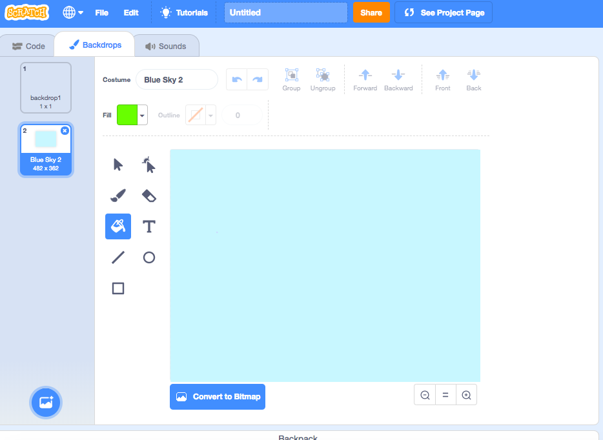
Create Your Homepage - Choose a Solid Background
Change to Any Color

Slide 18
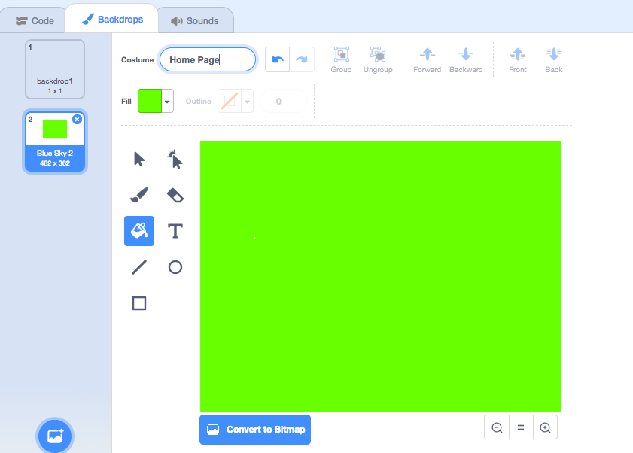
Create Your Homepage - Rename Background
Rename it “Home Page”

Slide 19
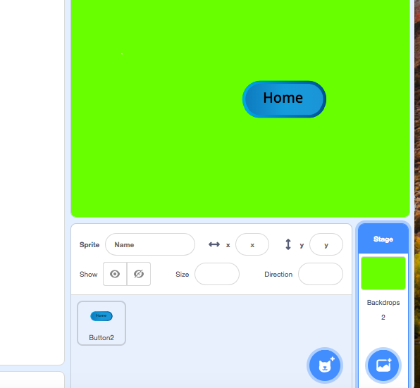
Create Your Homepage
Click on Button
Your back at your home page!

Slide 20
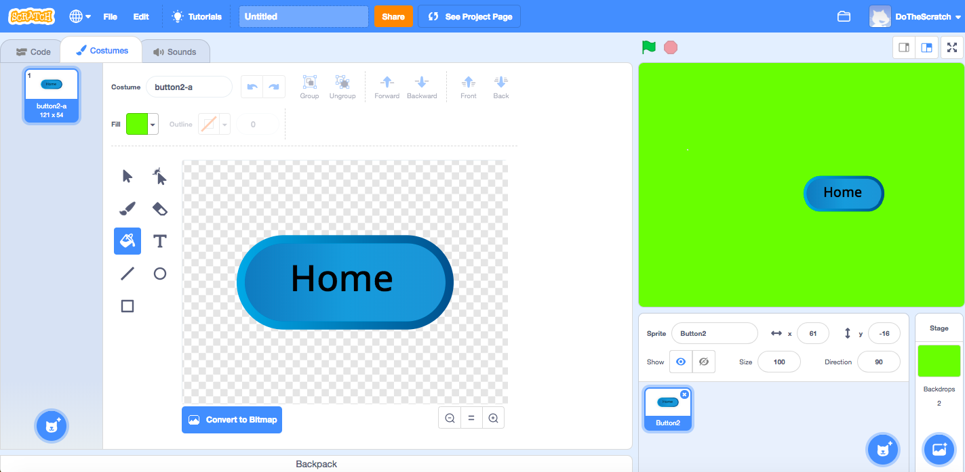
Basic Homepage - Phew!

Slide 21
Let’s Add a Title and Buttons for Subpages

Slide 22
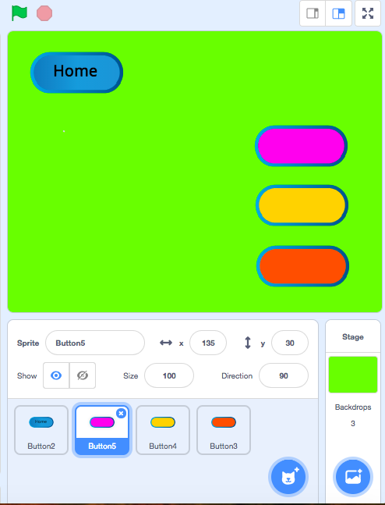
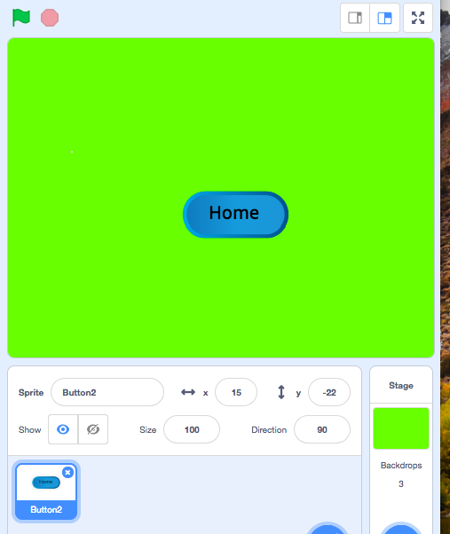
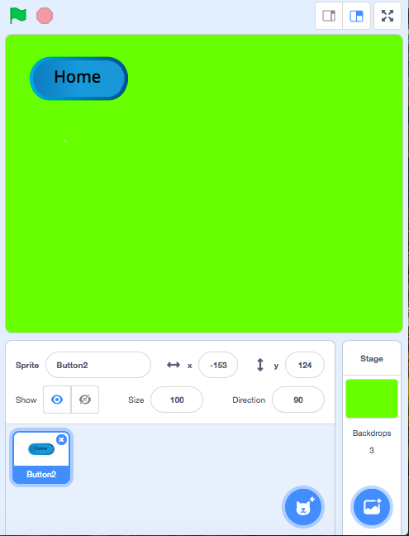
Move the “Home” Button
Add 3 Buttons

Slide 23
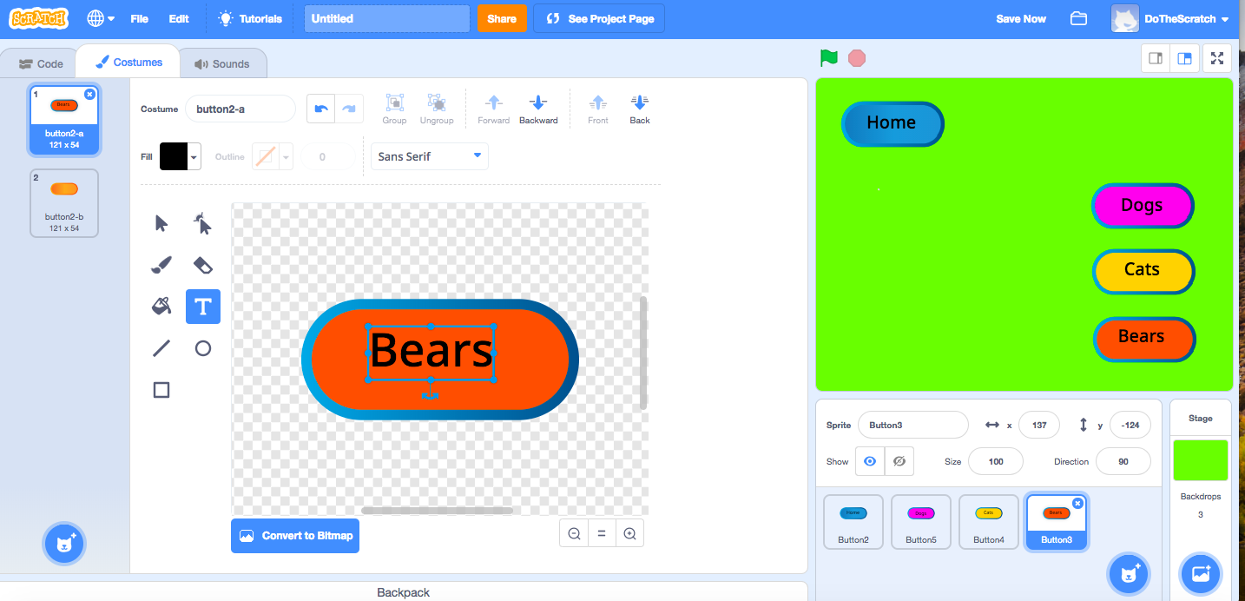
Click on Sprites to Change Color and Label

Slide 24
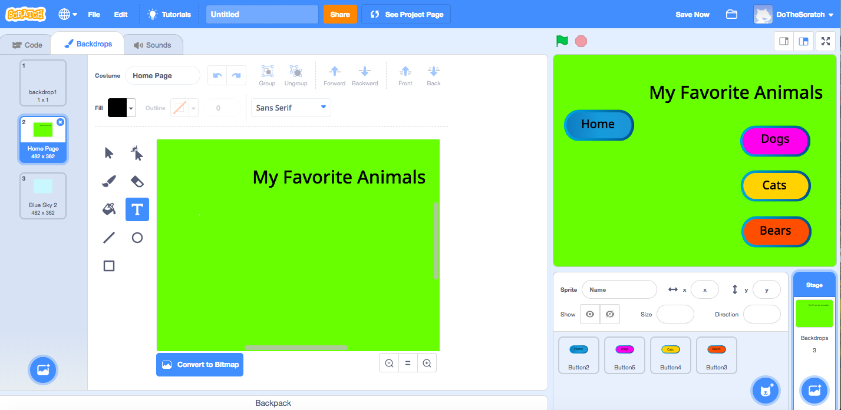
Add a Home Page Title - My Favorite Animals

Slide 25
Add Animal Subpages
Add a new Backdrop
Rename it “Dog Page”
Repeat for all other animals
Broadcast the Home & Subpage
Hide the Buttons

Slide 26
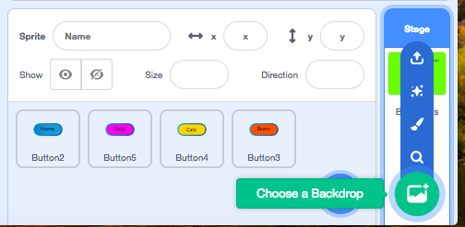
Choose a New Backdrop for the “Dog Page”

Slide 27
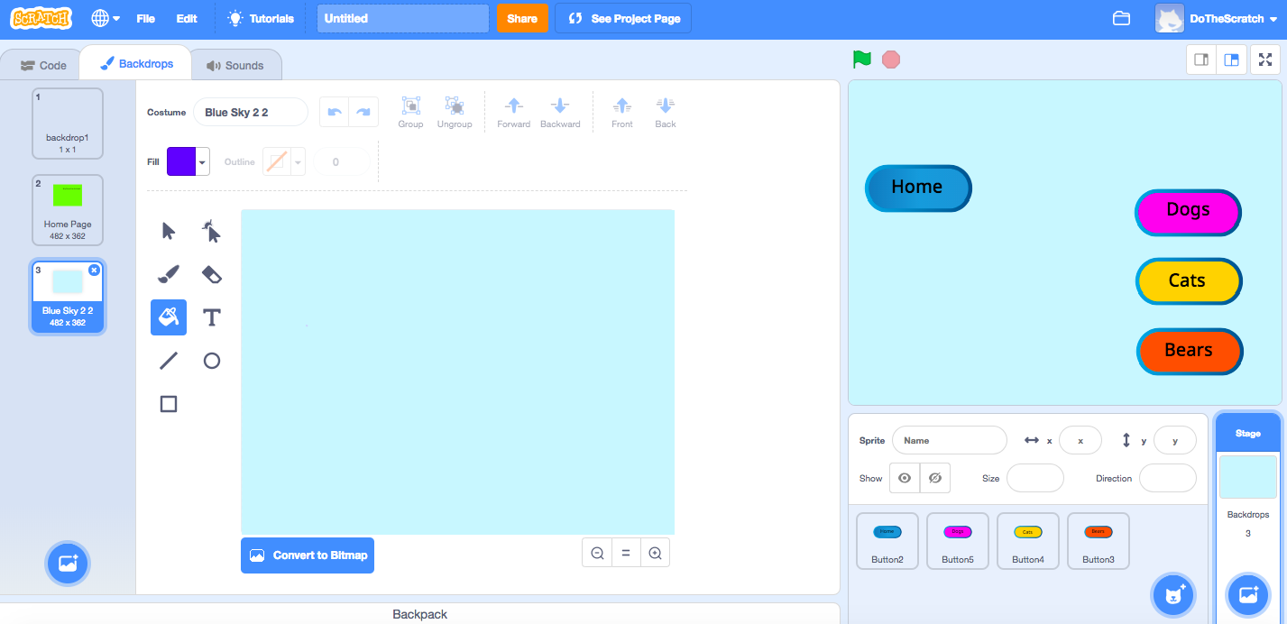
Change the Color for the “Dog Page”
Rename “Dog Page”
Change Color
New Backdrop

Slide 28
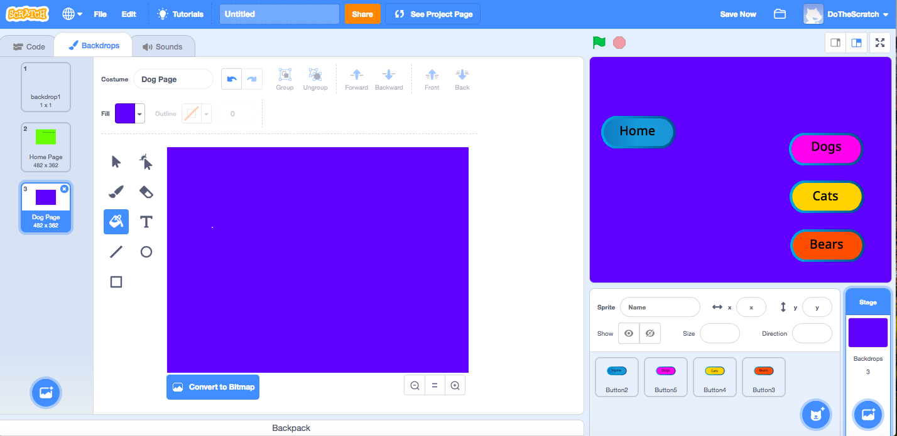
Label the “Dog Page” Like We Did Home Page

Slide 29
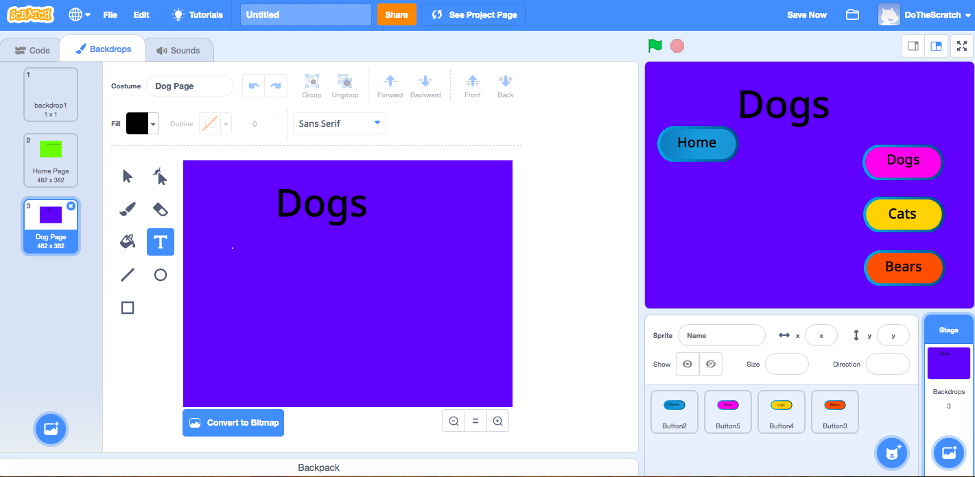
Label the “Dog Page” Like We Did Home Page
Repeat for Cats and Bears Backdrop and Labels

Slide 30
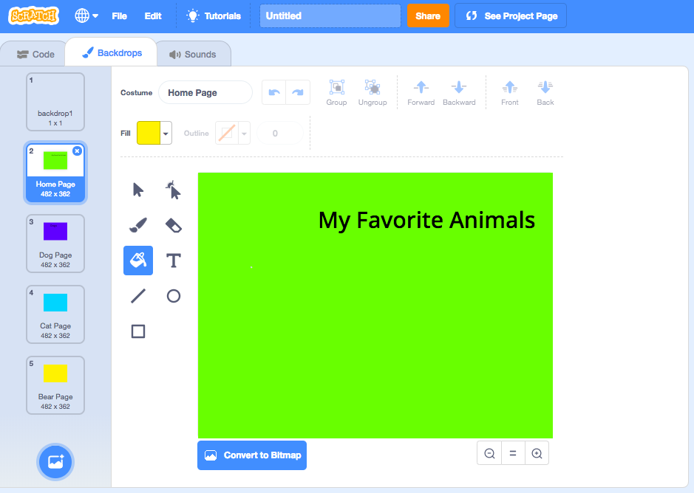
Label the “Dog Page” Like We Did Home Page
Repeat for Cats and Bears Backdrop and Labels

Slide 31
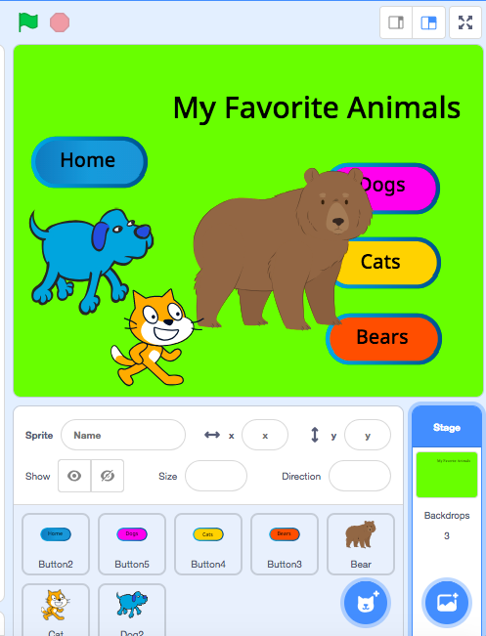
You should have your basic subpages.
Add animals to each of the pages by adding new sprites.
It’s going to get messy at first.
We need to find a way to hide things and have them show up on pages.
Use “When Backdrop Switches” & “When I Receive Broadcast” blocks.

Slide 32
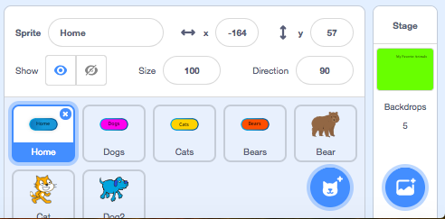
Rename the Buttons

Slide 33
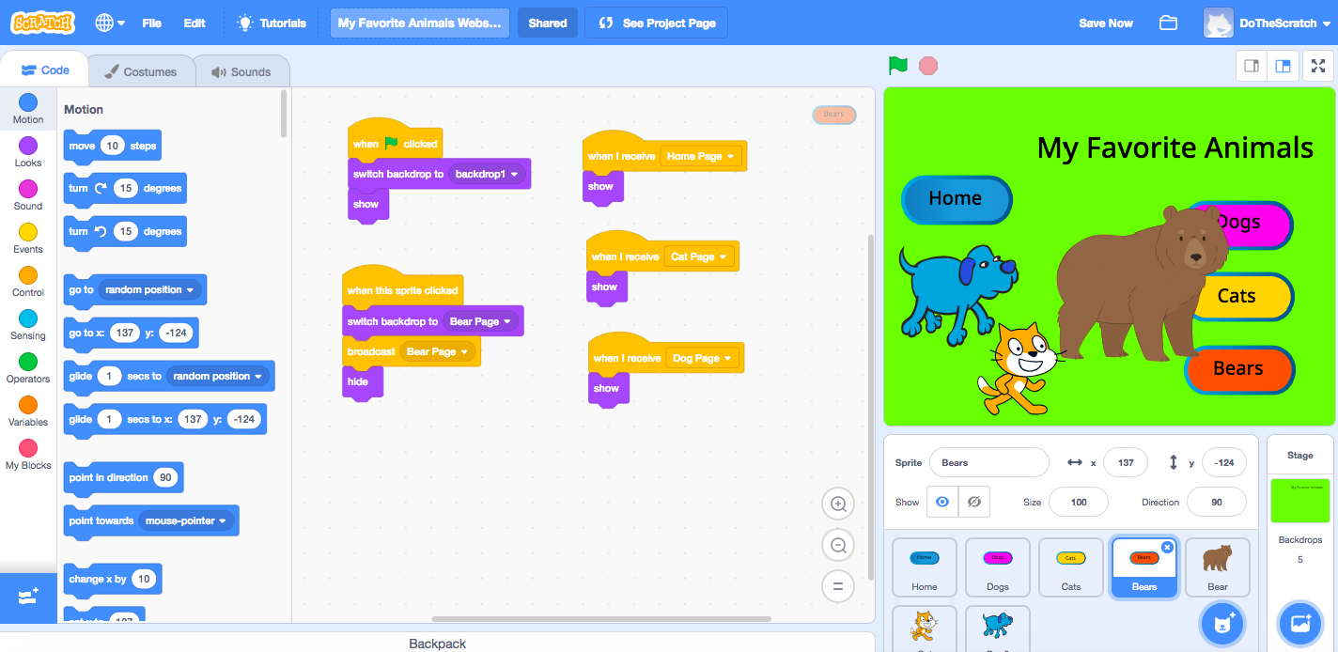
Homepage Code - Add Code to Homepage Button

Slide 34
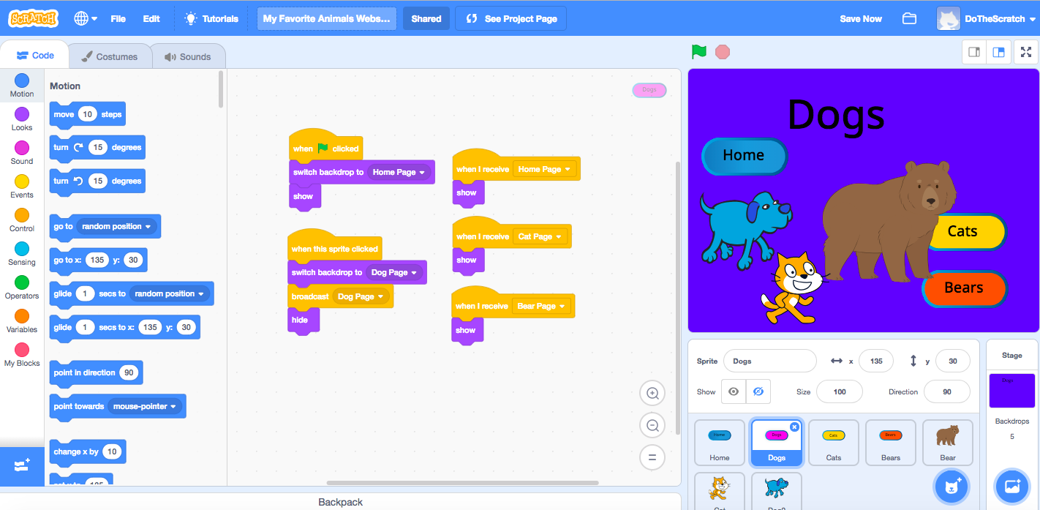
Subpage Code - Dog Page - Use Backpack to Copy Code for Cats/Bears

Slide 35
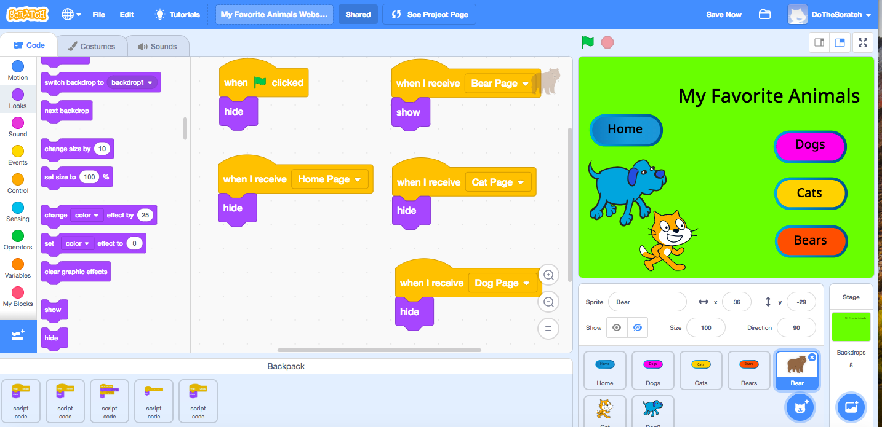
Click the “Bear” Sprite - Add Code to Hide / Show

Slide 36
Repeat Code for Cats and Dogs

Slide 37
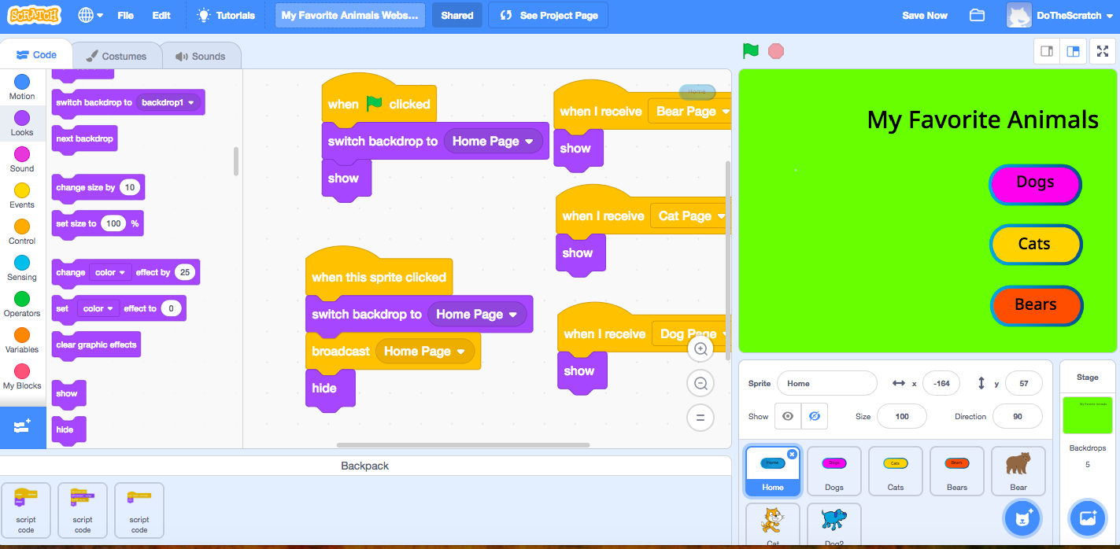
The Finished Product

Slide 38
Congratulations! You have a basic webpage.
Repeat these steps to add more subpages.
Use the “Broadcast” and “Receive Broadcast” to add new features to your pages when buttons are clicked.
Use Hide / Show for different sprites.
Add Motion, Sound, and Conditionals to make it interactive.
Possibilities are endless!

